Slide 1


Cloud-Enabled Fuel Consumption Analysis and Energy Efficiency Optimization for Hybrid Vehicles
CSA1522-CLOUD COMPUTING & BIG DATA ANALYTICS
Guided by :
Dr. Rajaram P
Name of the student :
P.Guru(192521010)
S.Bala(192524427)
D.Raghava(192525304)

Slide 2
Introduction
Hybrid vehicles combine an Internal Combustion Engine (ICE) and an Electric Motor to improve fuel efficiency and reduce emissions.
However, fuel consumption still varies depending on driving conditions such as speed, road slope, traffic, and battery usage.
Cloud Computing enables centralized storage, real-time data processing, and intelligent decision-making, making it possible to optimize fuel consumption and improve energy efficiency.
Notes:
Image source: https://pub.mdpi-res.com

Slide 3
Abstract
Hybrid vehicles play a significant role in reducing fuel consumption and emissions, but their efficiency depends on driving conditions such as speed, road slope, battery usage, and engine load. This project proposes a Cloud-Enabled Fuel Consumption Analysis and Energy Efficiency Optimization System that collects and stores vehicle data on a cloud platform for real-time analysis. The system processes these parameters to predict fuel consumption, recommend the optimal driving speed and driving condition, estimate mileage, and calculate the travel distance for 100 litres of fuel. By providing intelligent driving recommendations and centralized cloud-based monitoring, the proposed system aims to improve fuel efficiency, reduce operating costs, and support sustainable transportation, making hybrid vehicles more economical and user-friendly for Indian drivers.
Notes:
Image source: https://www.mdpi.com

Slide 4
Problem statement
Existing Problems:
High fuel consumption during improper driving.
Lack of real-time fuel efficiency recommendations.
No centralized storage for driving history.
Difficulty in identifying the most fuel-efficient speed.
Battery energy is not always utilized efficiently.
No personalized driving recommendations.
Notes:
Image source: https://www.mdpi.com

Slide 5
Objectives
Develop a cloud-enabled fuel monitoring system.
Analyze fuel consumption using cloud computing.
Recommend optimized driving conditions.
Improve hybrid vehicle energy efficiency.
Reduce unnecessary fuel consumption.
Generate cloud-based reports for drivers.
Notes:
Image source: https://pub.mdpi-res.com

Slide 6
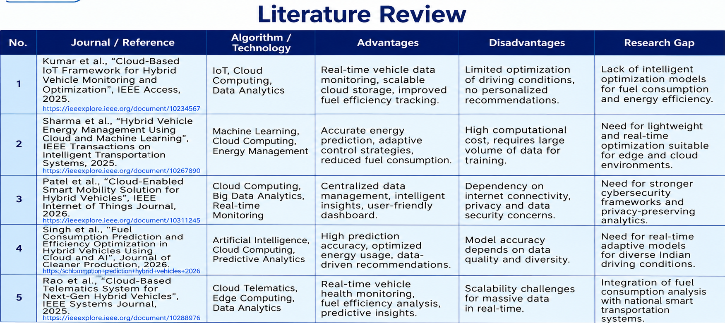
Notes:
Image source: https://pub.mdpi-res.com

Slide 7
Module 1 – Cloud-Based Data Acquisition and Storage
Inputs:
Vehicle Speed (km/h)
Road Slope (%)
Battery Level (%)
Engine Load (%)
Fuel Consumption (L/100 km)
Process:
Collect vehicle parameters.
Validate and preprocess the data.
Upload the data to the cloud database.
Maintain historical records for future analysis.
Output:
Secure cloud storage
Real-time vehicle data availability
Historical driving database
Cloud Concepts Used:
Cloud Storage
Database Services
REST API
Data Synchronization
Notes:
Image source: https://pub.mdpi-res.com

Slide 8
Module 2 – Fuel Consumption Analysis and Energy Efficiency Optimization
Inputs:
Vehicle Speed
Road Slope
Battery Level
Engine Load
Process:
Retrieve data from the cloud.
Calculate fuel consumption.
Analyze energy usage.
Evaluate driving conditions.
Determine the optimal speed for maximum efficiency.
Output:
Fuel Consumption (L/100 km)
Mileage (km/L)
Energy Efficiency Score
Optimized Speed
Techniques Used:
Statistical Analysis
Mean
Variance
Optimization Algorithms
Decision Logic
Notes:
Image source: https://pub.mdpi-res.com

Slide 9
Module 3 – Cloud-Based Recommendation and Monitoring System
Process
Generate personalized driving recommendations.
Display optimization results.
Monitor vehicle performance continuously.
Generate reports using historical cloud data.
Outputs
Recommended Driving Condition
Eco Driving Suggestions
Distance Covered for 100 Litres
Fuel Efficiency Status
Historical Performance Reports
Cloud Concepts Used
Cloud Dashboard
Data Visualization
Cloud Monitoring
Decision Support System
Notes:
Image source: https://pub.mdpi-res.com

Slide 10
Techniques Used
Cloud Computing
Cloud Storage
Cloud Database
REST API
Real-Time Processing
Statistical Techniques
Mean
Variance
Standard Deviation
Data Analysis
Fuel Consumption Analysis
Energy Efficiency Calculation
Notes:
Image source: https://pub.mdpi-res.com

Slide 11
Benefits for India
How will this help India?
Rising Fuel Prices
Drivers can reduce fuel expenses by following optimized driving recommendations.
Environmental Protection
Lower fuel consumption reduces CO₂ emissions.
Smart Transportation
Supports India's smart mobility initiatives.
Fleet Management
Useful for taxis, buses, delivery vehicles, and logistics companies.
Reduced Fuel Imports
Lower fuel consumption decreases dependence on imported petroleum.
Supports Electric Mobility
Helps improve the adoption of hybrid vehicles.
Notes:
Image source: https://www.mdpi.com

Slide 12
Conclusion
Cloud computing provides an intelligent platform for monitoring and optimizing hybrid vehicle performance.
By analyzing vehicle parameters in real time, the proposed system recommends efficient driving conditions, reduces fuel consumption, improves energy efficiency, and supports environmentally sustainable transportation.
Notes:
Image source: https://pub.mdpi-res.com

Slide 13
References
Kumar et al., "Cloud-Based loT Framework for Hybrid Vehicle Monitoring and Optimization", IEEE Access, 2025
Sharma et al., "Hybrid VehicleEnergy Management Using Cloud and Machine Learning", IEEE Transactions on Intelligent Transportation Systems, 2025.
Patel et al., "Cloud-Enabled Smart Mobility Solution for Hybrid Vehicles", IEEE Internet of Things Journal, 2026.
Singh et al., "Fuel Consumption Prediction and Efficiency Optimization in Hybrid Vehicles Using Cloud and Al", Journal of Cleaner Production, 2026.
Rao et al., "Cloud-BasedTelematics System for Next-Gen Hybrid Vehicles", IEEE Systems Journal, 2025.

Slide 14


